Slide 1


AIS201
Artificial Intelligence CV Ranking Project
Marwan Ghazal - 231000765
Omar Amin - 231000573
Mohamed Abdellatif - 231000119
Zeyad Ahmed - 231000010

Slide 2
Main Goal
Our project aims to build an intelligent system that can rank CVs (resumes) based on their relevance to the job description, using data from previously accepted and denied CVs.
The main goal is to train machine learning models that can predict the likelihood of an applicant being accepted or denied for a given job, and then rank the applicants accordingly.

Slide 3
Data Sources
The datasets were sourced from Kaggle and Hugging Face
The data consists of three main columns:
resume_Text: Textual content of applicant resumes.
job_description_text: Job posting descriptions.
decision: binary value indicating if a candidate was accepted (1) or denied (0).
Each job listing is associated with multiple CVs, creating a many-to-one relationship.
The dataset is textual and requires extensive preprocessing before modeling.

Slide 4
Data Preprocessing
01
Job Filtering
Jobs with fewer than 10 CVs were excluded from the data.
02
Class Balance Filtering
Jobs where all resumes are accepted or denied were removed from the data.
03
Outlier Detection
Resume and job description length distributions were visualized to identify outliers.
04
After filtering, job_id values were re-encoded to be contiguous for easier tracking.
Re-indexing

Slide 5
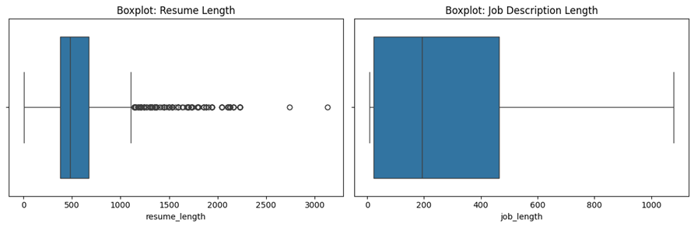
Outlier Detection

Slide 6
Encoding Techniques
01
02
03
TD-IDF
Term Frequency-Inverse Document Frequency
BERT
Bidirectional Encoder Representations from Transformers
spaCy Embeddings
Uses en_core_web_md to generate fixed-length vectors from the resumes and job descriptions.
Faster than BERT
Lighter semantic coverage.
Converts text into a matrix of weighted word count.
Captures Important words across documents.
Fast and interpretable.
Uses pre-trained transformer models to generate semantic embeddings.
Captures deep contextual relationships.
Ideal for transfer learning with rich language understanding.

Slide 7
Modeling pt.1
Traditional Models
01
02
03
07
06
04
05
Logic Regression
Random Forest
K Nearest Neighbors
(KNN)
LinearSVC
XGBoost
Naive Bayes
(Gaussian)
LightGBM
Predicts the probability of a binary outcome using linear functions
Builds multiple decision trees and averages their prediction
Finds the optimal hyperplane that separates classes in high-dimensional space
Gradient boosting algorithm that builds trees sequentially, minimizing error.
A fast gradient boosting framework that uses histogram-based splitting
Assuming features are independent and normally distributed
Classifies based on the majority class among the K closest data points

Slide 8
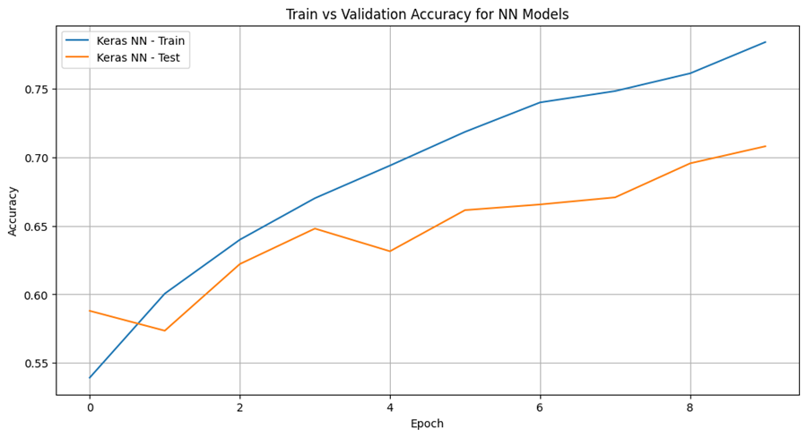
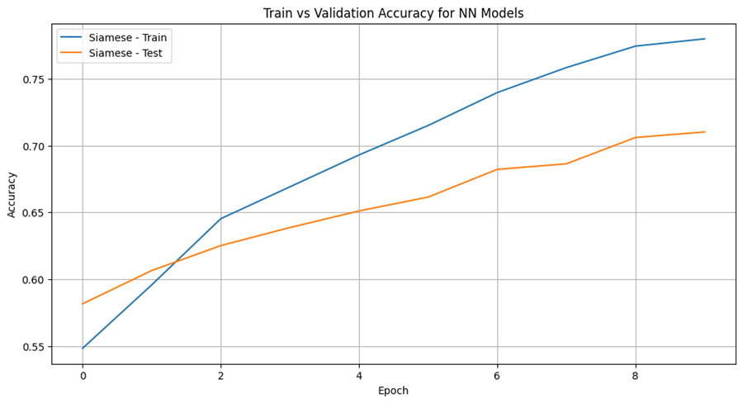
Modeling pt.2
Neural Networks
01
02
Keras Fully Connected Neural Network
Siamese Neural Network

Slide 9
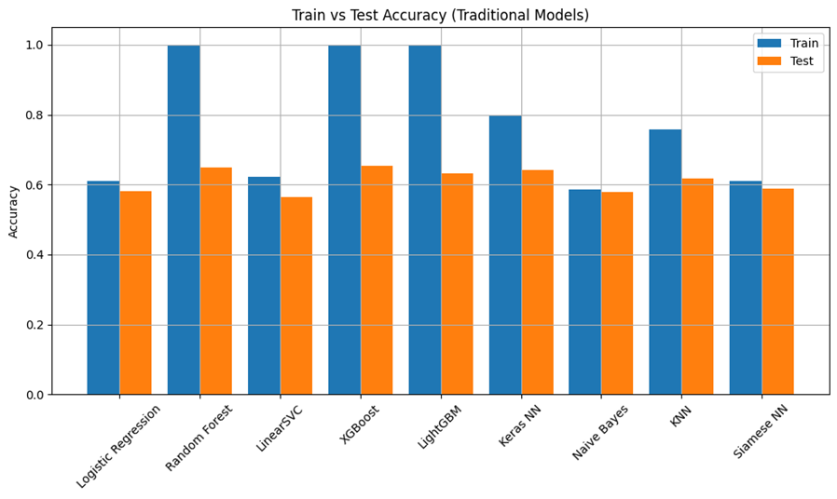
Overfitting Insights
Random Forest, XGBoost, and LightGBM showed significant overfitting across all encodings, with nearly perfect training accuracy but large drops on test data.
Keras and Siamese networks provided better generalization when properly tuned.

Slide 10
Fusion Model
To improve performance and robustness, we implemented a Fusion Model using XGBoost as a meta-classifier.
Inputs of Fusion Model
TF-IDF LinearSVC score
BERT Siamese NN score
spaCy Keras NN score

Slide 11
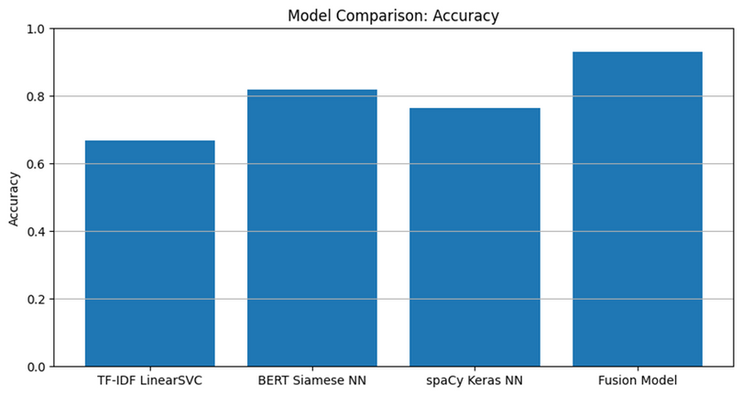
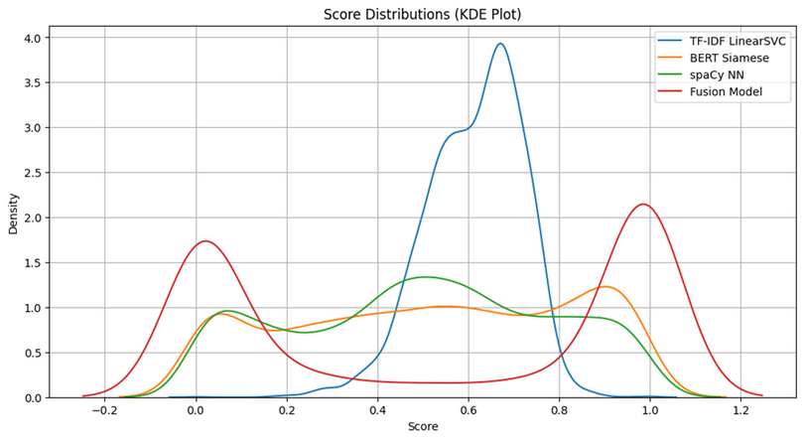
Fusion Model Results
The most confident score separations (as shown in KDE distributions).
The most bimodal probability distribution (ideal for ranking tasks).
Best average accuracy and AUC across the dataset.

Slide 12
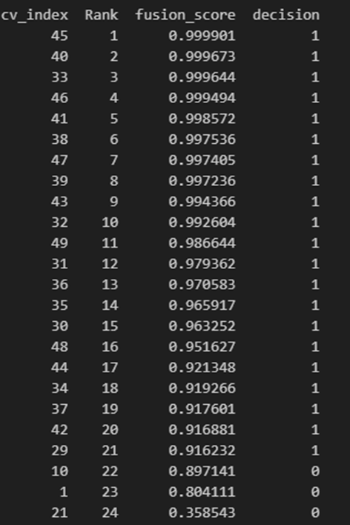
Final Ranked CVs
Using: get_ranked_cvs(job_id=3)
The following returns the top CVs for a specific job, ordered by predicted suitability.

